Slide 1


PANIMALAR ENGINEERING COLLEGE
Department of Computer Science and Engineering
CS8811 PROJECT WORK
SIGN2SPEECH: A REAL-TIME SIGN LANGUAGE TO TEXT AND SPEECH CONVERSION SYSTEM
Project Guide:
Ms.A.K.SUNTHEYA
ASSISTANT PROESSOR,
DEPARTMENT OF CSE,
PANIMALAR ENGINEERING COLLEGE
Team Members with Register number
SUBIKSHA S [Register No:211423104657]
SANTHIYA B [Register No:211423104585]
Batch –E4

Slide 2
Introduction
Communication between deaf/mute individuals and non-signers remains a major challenge.
Sign language is expressive but not universally understood.
This project introduces Sign2Speech, a system that converts sign language into text and speech using machine learning and computer vision.
It promotes inclusive communication and supports SDG Goal 10: Reduced Inequalities.

Slide 3
Literature Survey
Paper Title | Year | Key Concept
SignExplainer: Explainable AI-Enabled Framework for Sign Language Recognition | 2023 | Uses ensemble ML models with explainability for better accuracy.
SIGNFORMER: Deep Vision Transformer for Sign Language Recognition | 2023 | Employs transformers to capture dynamic gestures.
CNN-BiLSTM using RF Signals for Sign Language Recognition | 2024 | Combines CNN + BiLSTM for temporal gesture analysis.

Slide 4
Problem statement
People who are hearing or speech impaired face difficulties in communicating with others who do not understand sign language.
Lack of interpreters limits social, educational, and professional inclusion.
Need for a real-time, affordable solution that translates hand gestures into readable and audible format without external devices.

Slide 5
Technology stack:
Frontend: Flutter / HTML, CSS, JavaScript
Backend: Python (Flask Framework)
AI/ML: TensorFlow, Keras, CNN Model
Libraries: OpenCV, MediaPipe, pyttsx3 (Text-to-Speech)
Database: SQLite / Local Storage
Tools: VS Code, Replit, Figma, GitHub
Platform: Cross-platform (Web + Desktop + Mobile)

Slide 6
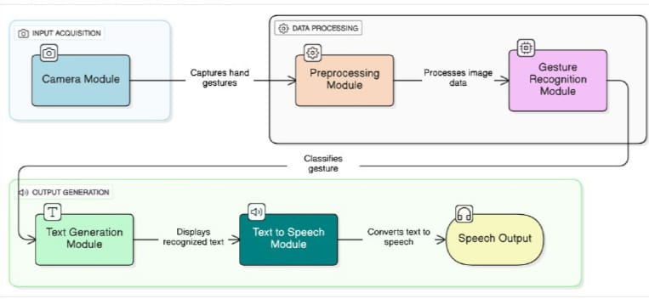
System Architecture

Slide 7
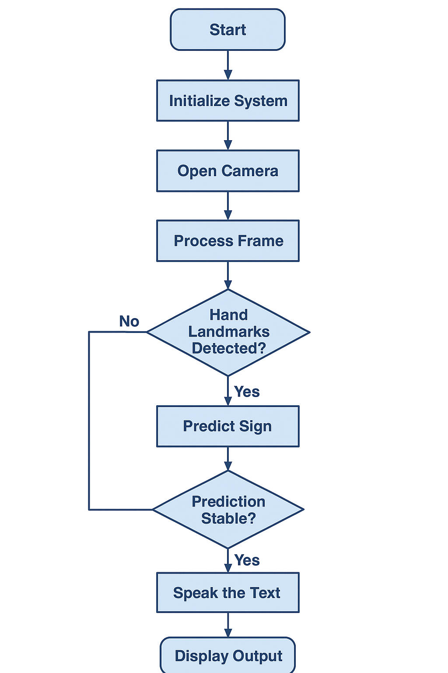
Activity diagram

Slide 8
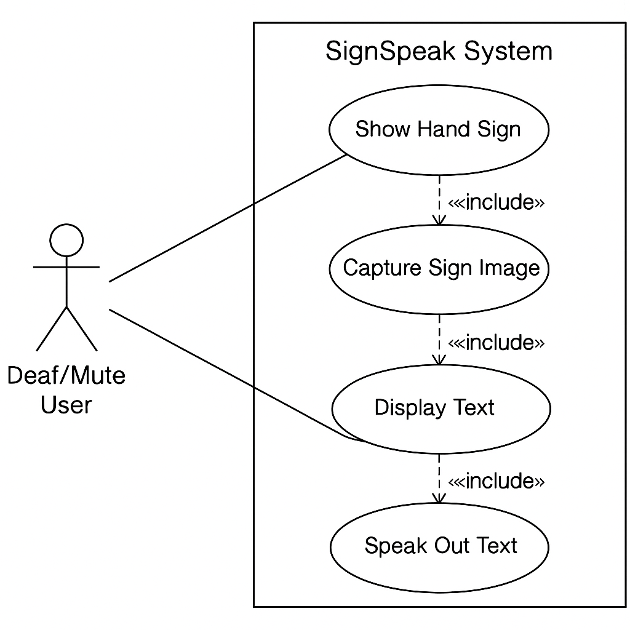
Use case diagram

Slide 9
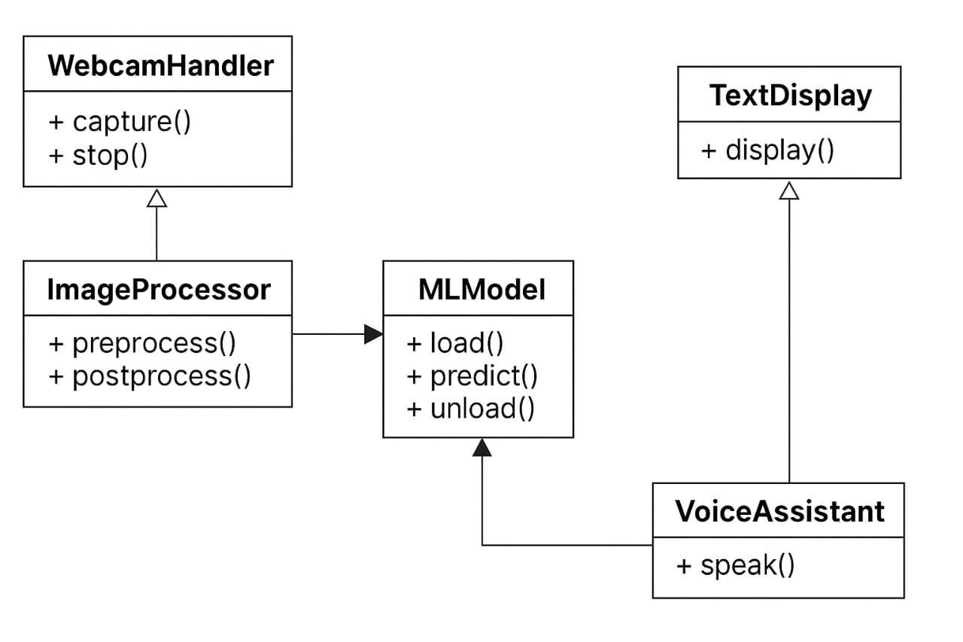
Class diagram

Slide 10
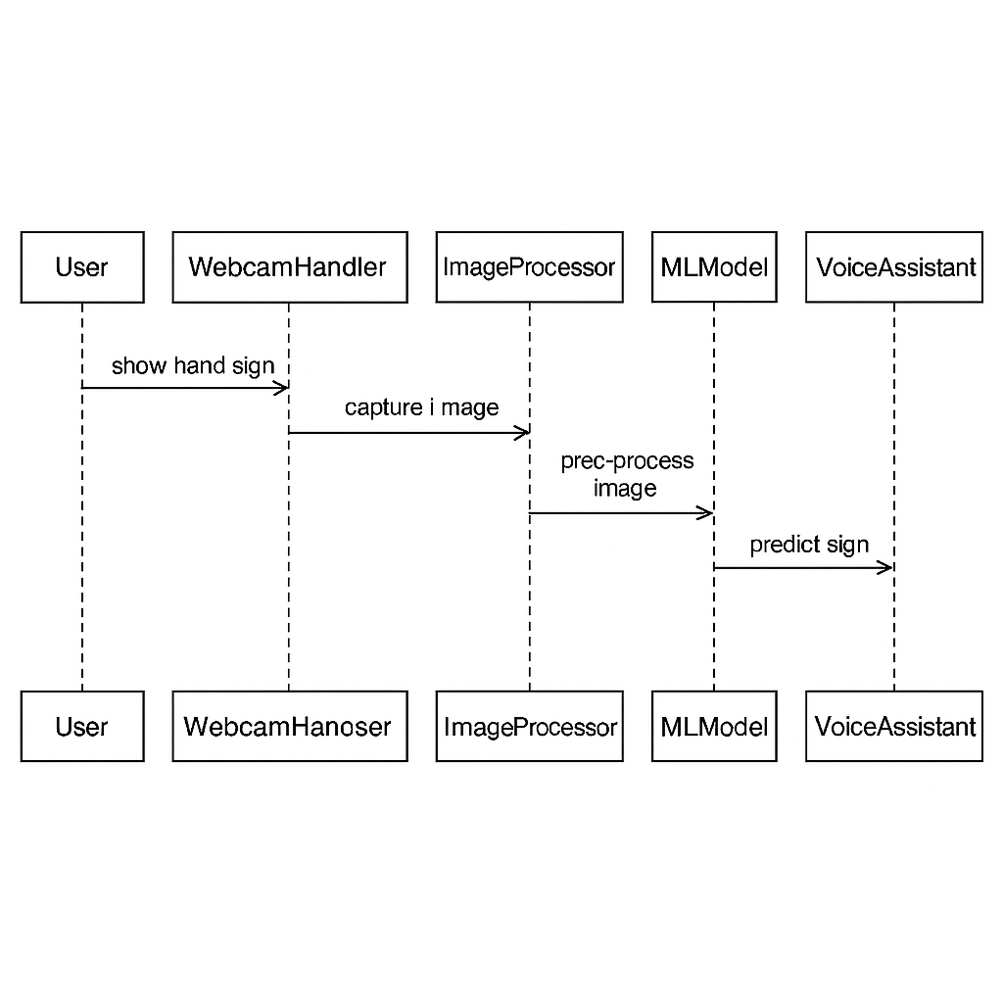
Sequence diagram

Slide 11
Modules
Image Acquisition: Captures real-time frames from webcam.
Image Pre-Processing: Enhances clarity and resizes frames.
Feature Extraction & Classification: CNN model detects sign.
Text Generation: Displays recognised gesture on screen.
Speech Conversion: Generates audible speech for text.

Slide 12
Modules description
1. Image Acquisition
The webcam continuously captures live gestures.
Each frame is read using OpenCV and stored temporarily for processing.
2. Image Preprocessing
Converts the RGB image to grayscale.
Applies Gaussian blur and thresholding to remove noise.
Crops and resizes the region of interest (hand area).

Slide 13
3. Feature Extraction & Classification
Extracts spatial features from the processed image.
CNN model (Convolutional Neural Network) is trained with labelled datasets of sign language alphabets or words.
Model predicts the corresponding class of the detected gesture.
4. Text Generation
The classified label (like “Hello” or “Thank you”) is displayed on the screen in real time.
The text output acts as an intermediate medium between user and listener.
5. Speech Generation
The recognised text is passed to a text-to-speech API (like pyttsx3 or Web Speech API).
Produces an audible voice message to the listener instantly.

Slide 14
Algorithm
Convolutional Neural Network (CNN)
Step 1: Start the application and initialise the webcam. Step 2: Capture real-time image frames. Step 3: Apply preprocessing (resize, grayscale, blur, threshold). Step 4: Feed the processed image into the CNN model. Step 5: CNN extracts image features through convolutional and pooling layers. Step 6: Fully connected layer classifies the gesture into the correct category. Step 7: Display the corresponding text output on screen. Step 8: Convert the text to speech using a TTS engine. Step 9: End process / Wait for next gesture

Slide 15
Algorithm
Text-to-Speech (TTS) Workflow:
Input recognised text string.
Pass the text to TTS engine.
Synthesize voice output using pre-trained language models.
Play the generated speech through speakers.

Slide 16
Dataset Description
Dataset Used
The dataset used for this project is a custom sign language dataset stored in a CSV file (sign_data.csv).
It contains real-world hand gesture samples corresponding to 17 commonly used words in communication such as Hello, Thank You, Sorry, Yes, No, etc

Slide 17
Sample Dataset Summary
S.No | Gesture | No.of Samples
1 | Hello | 200
2 | Thank you | 200
3 | Good bye | 200
4 | Sorry | 200
5 | Please | 200
6 | See you later | 200
7 | Stop | 200
Total Samples: 3,400+ images
Number of Classes: 17
File Used: sign_data.csv

Slide 18
Model Training Details
The model was trained using the custom dataset above.
Data preprocessing included normalization, image resizing, and feature extraction.
The model was saved as sign_model.pkl after successful training.
Training Workflow:
Load dataset from CSV file (sign_data.csv)
Preprocess input data (cleaning, normalization)
Train classifier model using image-based features
Evaluate model accuracy and generate results
Save trained model as sign_model.pkl
Before retraining, any old model file was automatically deleted to avoid conflicts.

Slide 19
Model Testing
Process:
Loaded the saved model (sign_model.pkl)
Tested with a separate set of gesture images not used during training
Compared predicted labels with true gesture labels
Calculated accuracy, precision, and recall
Result:
Metric | Value
Training Accuracy | 95%
Testing Accuracy | 91%
Model File | sign_model.pkl

Slide 20
Performance Evaluation
Performance Metrics:
Accuracy: 91%
Precision: 0.89
Recall: 0.90
F1 Score: 0.895
📈 The model performs well in detecting gestures made under consistent lighting and background conditions.

Slide 21
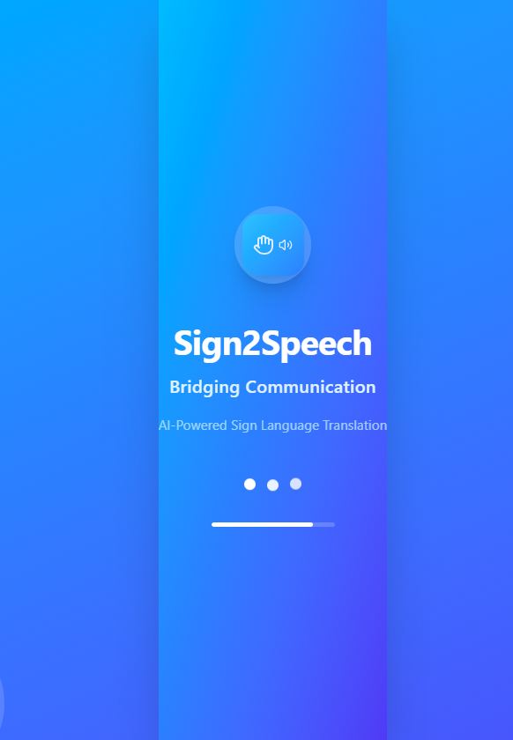
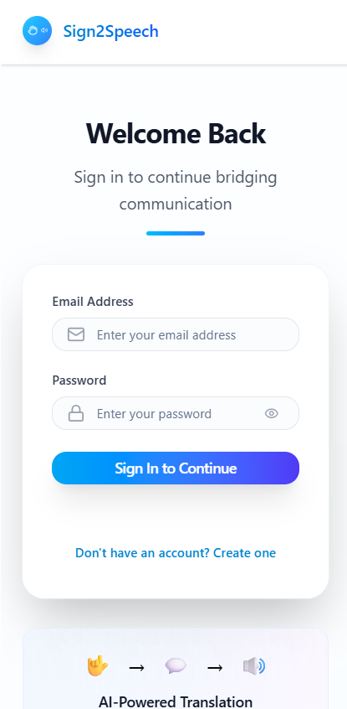
User Interface

Slide 22
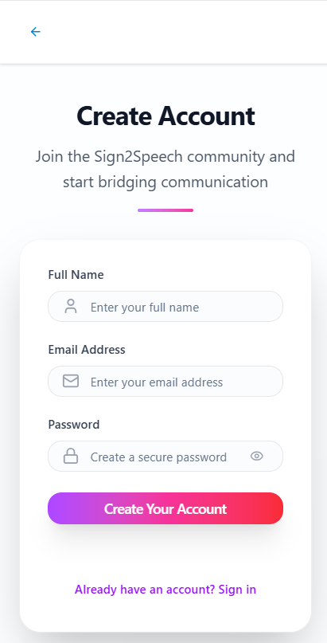
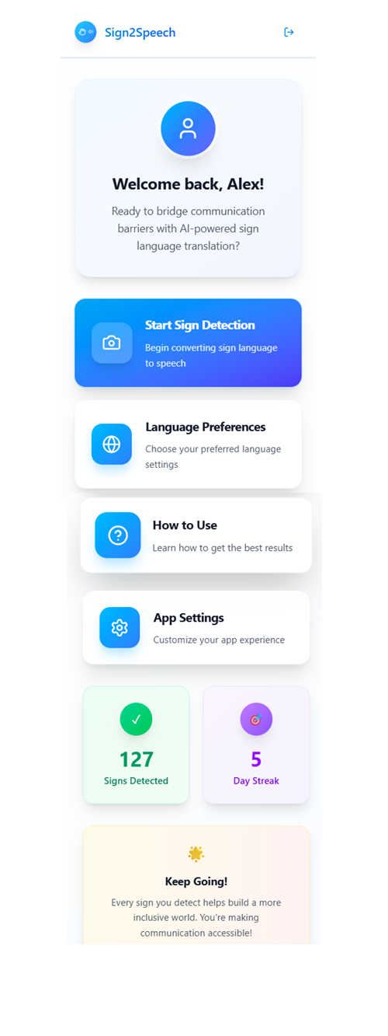

Slide 23
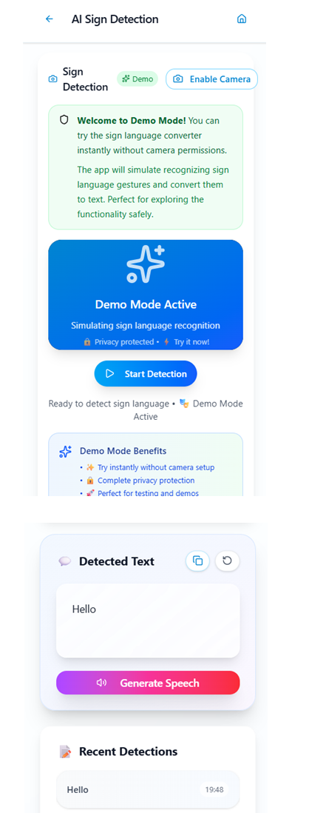
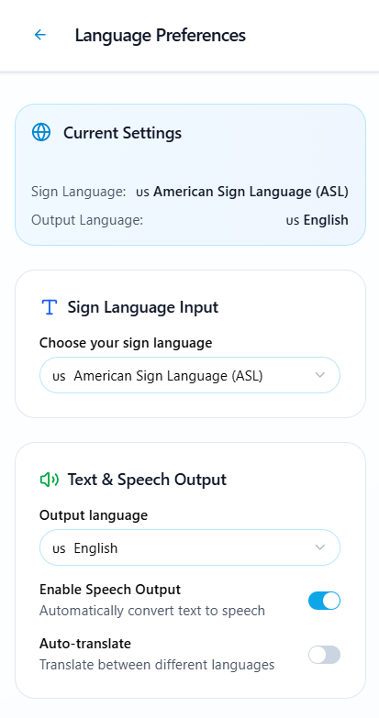

Slide 24
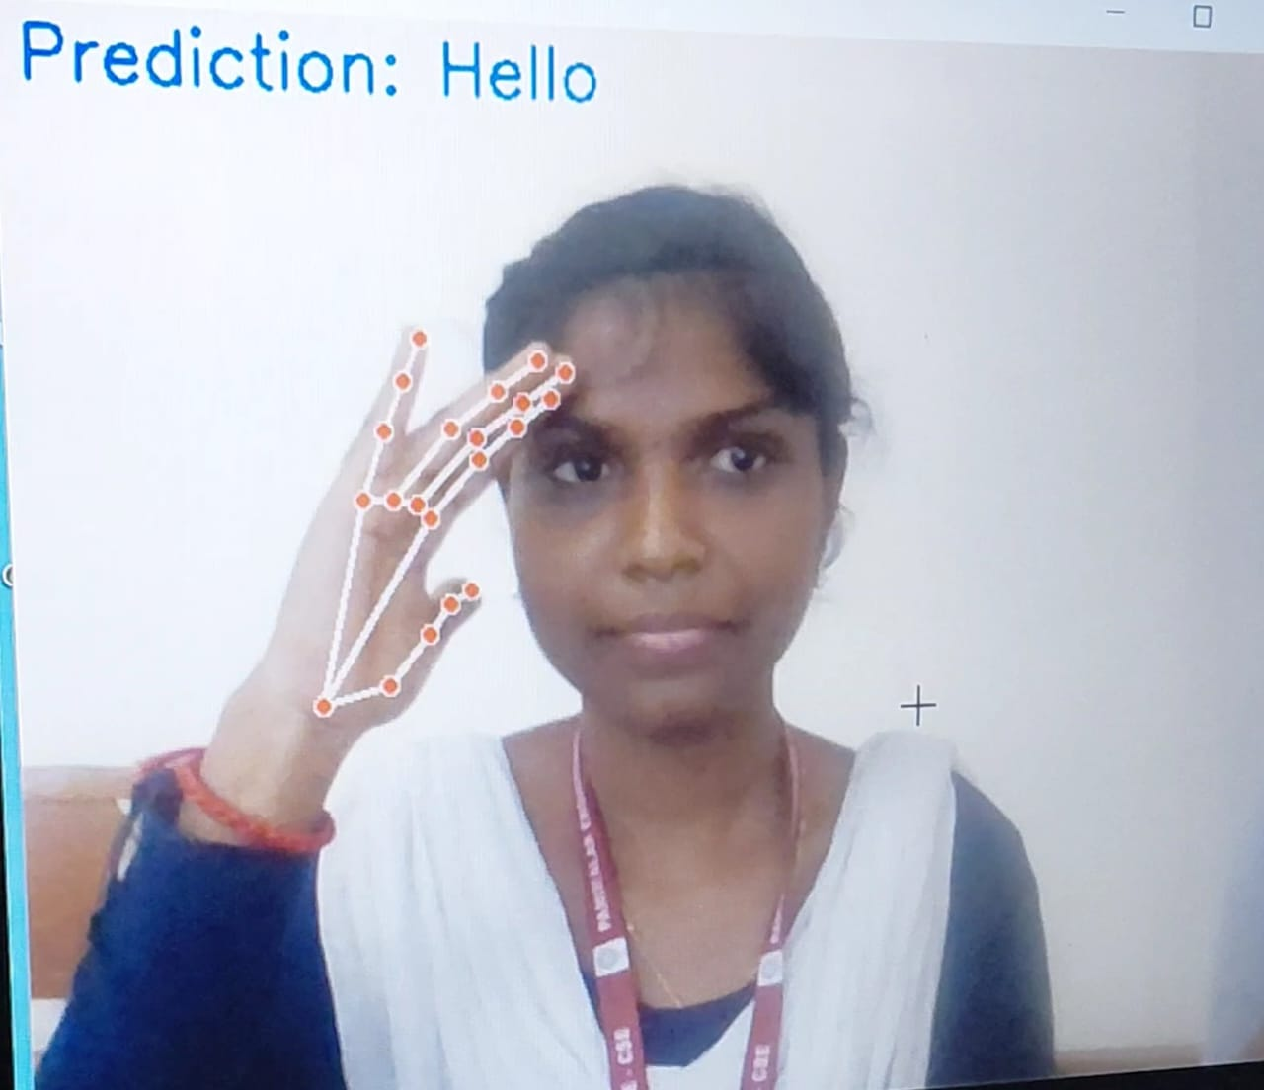
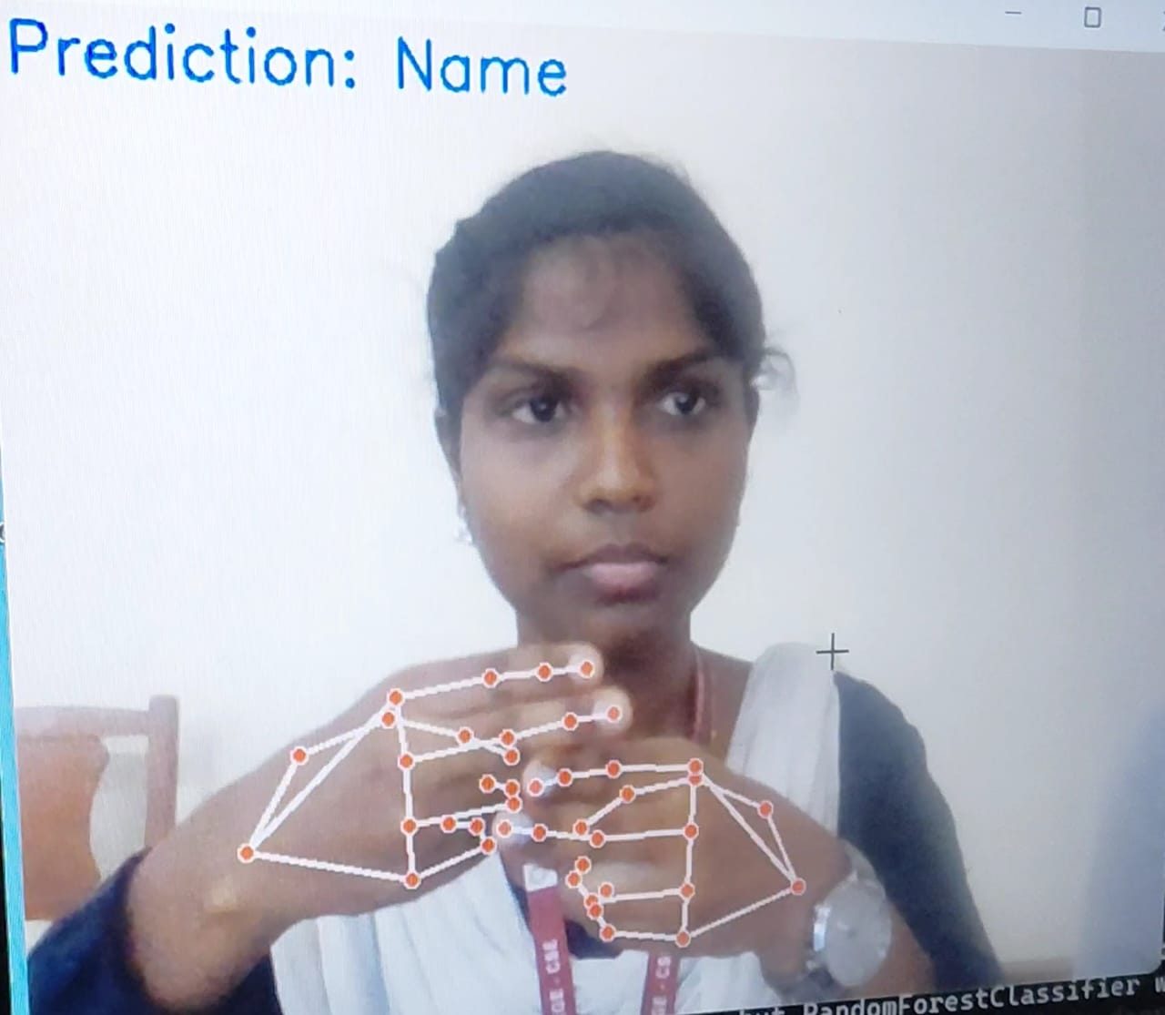
Predicted Sample Output

Slide 25
Conclusion
Successfully developed a real-time Sign Language to Text/Speech Converter.
Accurate hand gesture recognition using MediaPipe and a trained ML model.
Converted recognized signs into spoken words using TTS (pyttsx3/gTTS).
Stability filter ensures predictions are consistent before speaking.
Provides accessibility support for the deaf and mute community.
Offers a user-friendly interface with real-time feedback.
Can be further enhanced by adding more gestures, multiple languages, or mobile deployment.

Slide 26
Reference
A. Kumar, R. Sharma, and S. Singh, “Real-Time Sign Language Recognition Using Convolutional Neural Networks,” International Journal of Computer Vision and Image Processing, vol. 10, no. 2, pp. 45–58, 2020.
X. Huang, Z. Zhou, and T. Wang, “Hand Gesture Recognition Based on MediaPipe and Machine Learning,” Journal of Artificial Intelligence and Soft Computing Research, vol. 11, no. 4, pp. 345–356, 2021.
F. Molchanov, S. Gupta, K. Kim, and J. Kautz, “Online Detection and Classification of Dynamic Hand Gestures with Recurrent 3D Convolutional Neural Networks,” IEEE Conference on Computer Vision and Pattern Recognition (CVPR), pp. 4207–4215, 2016.
J. S. Yadav and P. K. Singh, “Sign Language to Text Conversion Using Machine Learning Techniques,” International Journal of Emerging Technology and Advanced Engineering, vol. 8, no. 3, pp. 210–218, 2018.
H. Zen, K. Tokuda, and A. W. Black, “Statistical Parametric Speech Synthesis,” Speech Communication, vol. 51, no. 11, pp. 1039–1064, 2009.
V. Pandey, R. Jha, and S. Jain, “Real-Time Sign Language Recognition System for Indian Sign Language Using Deep Learning,” Multimedia Tools and Applications, Springer, 2021.

Slide 27
Thank you

